Slide 1
INVESTMENT CASE STUDY
Group Members:
Bhanu Pratap
Shadab Hussain
Nidhi Tripathi
Vikash Bajaj

Slide 2
Abstract
Our company Spark Funds, an asset management company wants to make investments in a few companies for which we want to understand the global trends in investments so that the investment decisions can be taken effectively.
Minor Constraints to be kept in mind:
Investment has to be between 5 to 15 million USD per round of investment.
Investment only in English-speaking countries
Strategy to be followed :
Invest where most other investors are investing.
How to achieve this strategy
Identify the best sectors, countries, and a suitable investment type for making investments.
The overall strategy is to invest where others are investing, implying that the best sectors and countries are the ones where most investments are happening.

Slide 3
Problem Solving Methodology
Methodology
Investment Type Analysis
Avg. Investment Amount ( 5-15 Million USD)
Country Analysis
Top 9 Countries (having highest investment)
Sector Analysis
Best Investment Type
Top 3 Countries (English Speaking)
Best sector “Invest where most investments are occurring ”
Top 3 Sectors

Slide 4
Analysis- Data Source
It’s real investment data for analysis from crunchbase.com
For this research we analysed below databases:
1.) Companies (Basic data of companies)
2.) Rounds2 (Funding round details)
3.) Mapping.csv file has the mapping between category list and main sector

Slide 5
Investment Type Analysis – 1st Goal
Here we are considering Three main key consideration for analysis:
1.) The type of the company (Startup, Corporate, etc)
- We have chosen Venture, Seed, Angle, Private Equity type companies
2.) Stage of the company (Early stage startup, funded startup, etc.).
- We have mainly focused on more investor attracting companies i.e. startups
3.) The amount of funding
- We have considered 5 million USD to 15 million USD funding companies

Slide 6
Country and Sector Analysis – 2nd and 3rd Goal
As an outcome of Investment Type analysis, we are proceeding with below steps:
The highest total funding (Top 9 Countries)
-To find Top 9 countries which have received the highest total funding across ALL sectors for the chosen investment type
2. Identify Top three countries
- We have used data frame to identify the top three English-speaking countries from the top9 countries.
Sector Categorization
-In sector analysis, we identified the top three sectors countries vise (main_sectors).
Below are the eight sectors:
Automotive & Sports,Cleantech / Semiconductors, Entertainment
Health
Manufacturing
News, Search and Messaging
Others
Social, Finance, Analytics, Advertising
To find the most heavily invested main sectors in each of the three countries (for funding type FT and investments range of 5-15 M USD).

Slide 7
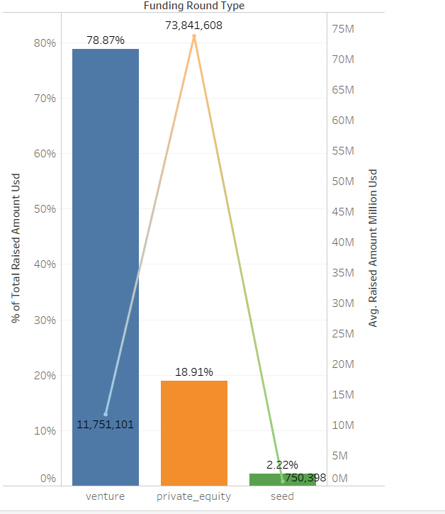
Results
Venture capital is the most suited finding type and its Average $11,751,101 USD

Slide 8
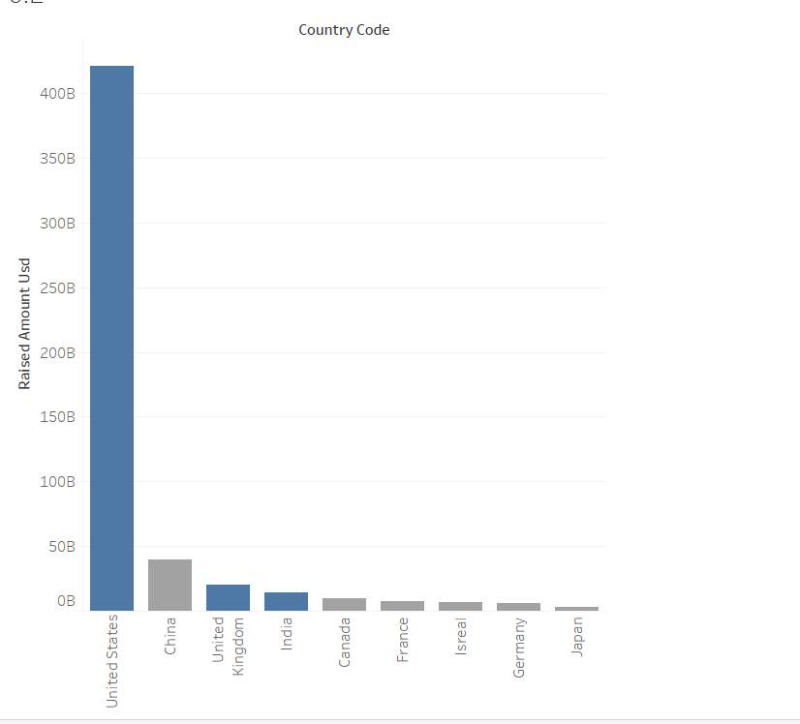
Results
Top three English Speaking countries are US, UK and India
China is not a English speaking country

Slide 9
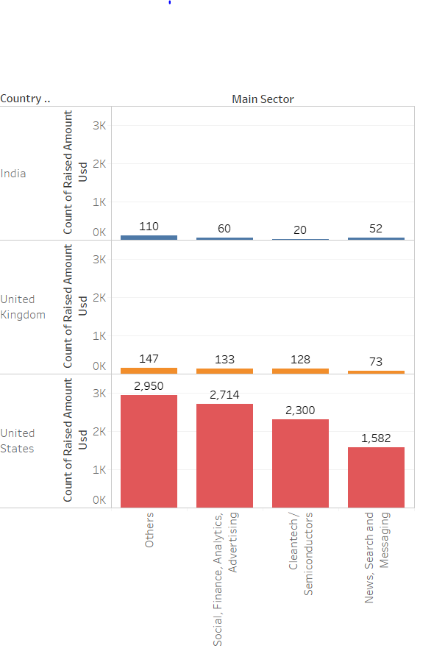
Results
Other sector has maximum investments in all three countries.

Slide 10
Conclusions
Venture Type is most suited funding type.
The USA, Great Britain and India are the most heavily (in venture funding ) funded countries.
Top 3 (Venture capital) sectors in the respective countries are as below:
Sectors | USA | GBR (UK) | IND
Top Sector | Others | Others | Others
Second Best Sector | Social, Finance, Analytics, Advertising | Social, Finance, Analytics, Advertising | Social, Finance, Analytics, Advertising
Third Best Sector | Cleantech /Semiconductors | Cleantech /Semiconductors | News, Search, Messaging

